Slide 1
BEER!
Explain why we chose this particular topic

Slide 2
Hypothesis:
hypothesis
Null hypothesis

Slide 3
Data used
citations
Census
Kaggle
Brew whatever .com
Mapquest API
Plotly API

Slide 4
General Assumptions
In effort to save time we made the following assumptions/inferences based on brew whatevers data:
1
2
3
DATA LIMITATIONS!!

Slide 5
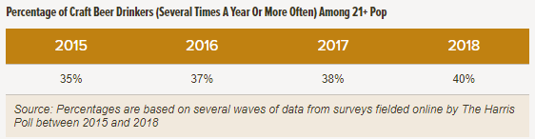
Craft Beer Drinkers Demographics
Demographics Historically
Males
Higher Social Economic Status (SES)
Late 30’s Age Group
Non Hispanic Population
Notes:
https://www.brewersassociation.org/insights/shifting-demographics-among-craft-drinkers/

Slide 6
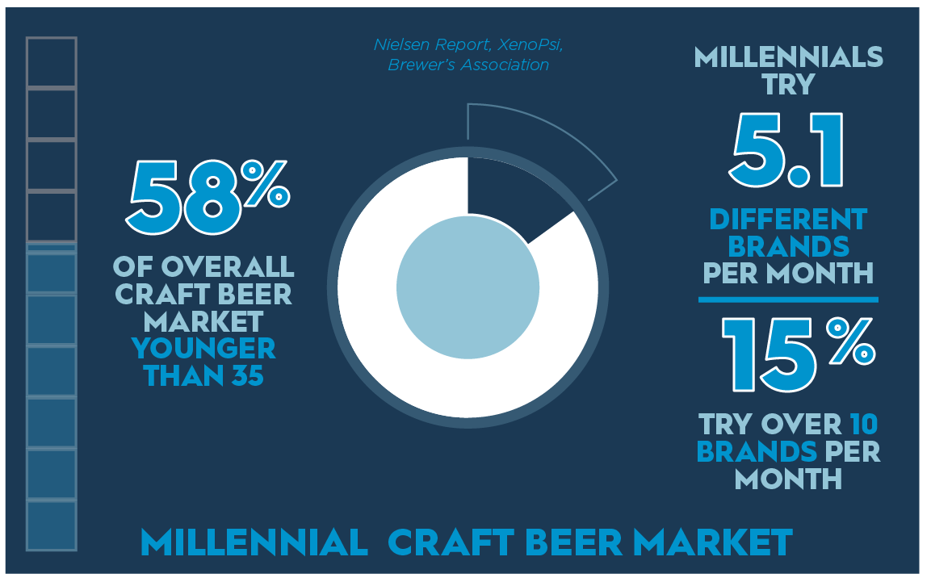
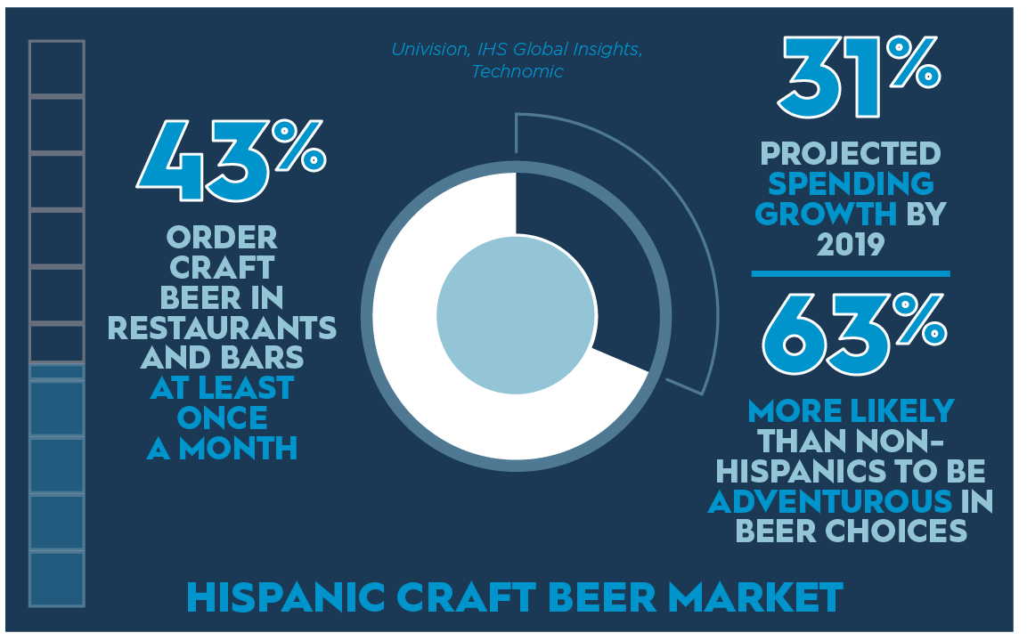
Craft Beer Drinkers Changing Demographics
Males still continue to make up majority
Higher Social Economic Status (SES)
But there are two demographics that are helping shape the craft beer markets…
Notes:
https://www.craftbrewingbusiness.com/featured/understand-age-changing-demographics-craft-beer-drinkers-market-properly/
~ 70% are males

Slide 7
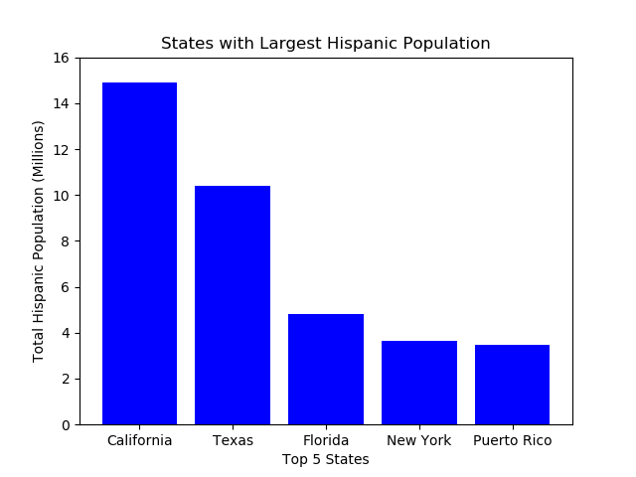
Census Data Exploration and Cleaning
Obtained from US Census Bureau Total Population by State (Hispanic Population)
Cross referencing the above states that contain sanctuary cities we find Texas has a non sanctuary city and sanctuary city close in latitude and population.
HOUSTON (SANCTUARY) VS SAN ANTONIO (NON SANCTUARY)
Notes:
Able to generate a CSV file that could then use Python to analyze
- Little cleaning required mostly on header information.
Generated using Matplotlib

Slide 8
Houston vs San Antonio Census Data
Obtained from US Census Bureau Texas Population Statistics for the following:
Age Demographics
Race Demographics
Sex Demographics
Income Demographics
Cleaning of Data
Read and Merging files
Adding Calculations for Target Population
Formatting data
Creation of new Data Frame’s for only counties pertaining to Houston or San Antonio
Generation of maps by Target Population and Household Income (Mean) using GEO ID
Notes:
Able to generate a CSV file that could then use Python to analyze
- Data presented by County and contained GEO ID
- Required merging 4 data sets into one
- Then created new dataFrame with only San Antonio and Houston
- Little cleaning required mostly on header information.

Slide 9
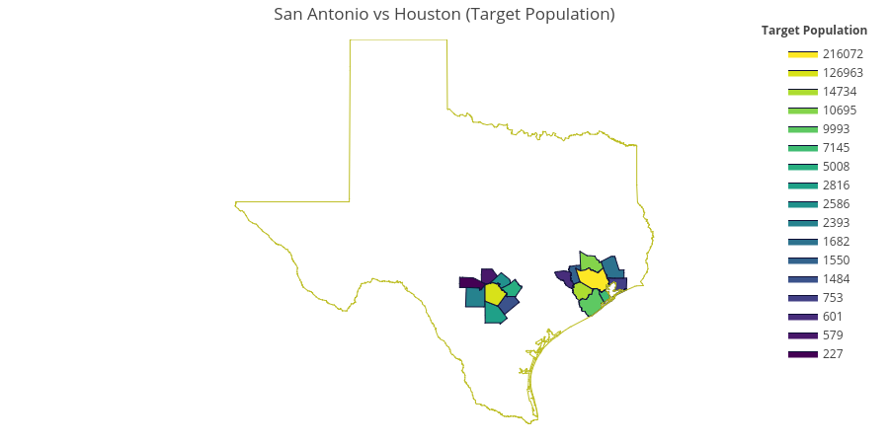
Results for Target Population
Harris County (Houston) – 216,072
Bexar County (San Antonio) – 126,963
Fort Bend (Houston) - 14,734

Slide 10
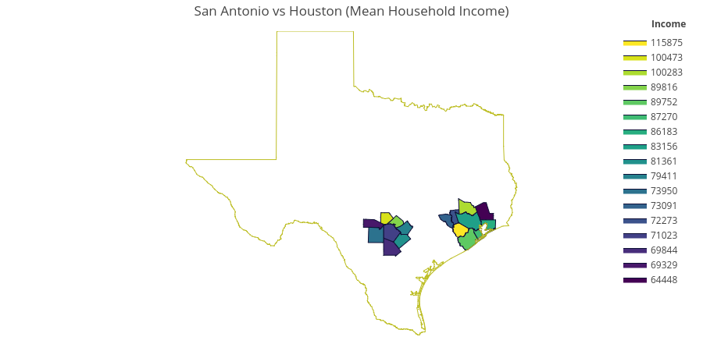
Results for Total Household Income (Mean)
Fort Bend (Houston) – $115,875 (3rd in Target Population)
Kendall (San Antonio) – $100,473 (16th in Target Population)
Montgomery (Houston) - $100,283 (4th in Target Population)
Notes:
Harris county is 8th in income
Bexar county 14th in income

Slide 11
County | Target Population | Income
Harris | 216072 | 83156
Fort Bend | 14734 | 115875
Montgomery | 10695 | 100283
Brazoria | 9993 | 89752
Galveston | 7145 | 87270
Liberty | 1682 | 64448
Waller | 1550 | 72273
Chambers | 753 | 86183
Austin | 601 | 73091
Atascosa | 2816 | 69844
Bandera | 227 | 69329
Bexar | 126963 | 71023
Comal | 2586 | 89816
Guadalupe | 5008 | 79411
Kendall | 579 | 100473
Medina | 2393 | 73950
Wilson | 1484 | 81361

Slide 12
Census Data
Census data cleanup and exploration
Target population/ethnicity, density, and income level
Connect this to the “why”
Focus on Sanctuary vs non because of BLANK

Slide 13
After previous slide, focused on TX
TX demographics
San Antonio
Houston
Findings, maps, charts of just TX

Slide 14
General Overview of Brick and Mortar Breweries
Chart of locations
Bar of top ten states

Slide 15
Comparative Analytics
Based on census vs breweries we found the following to be interesting
1
2
3
Comparative bar graph
Latino pop of cities vs breweries in those cities

Slide 16
Where we would suggest targeting distribution in TX
Map of plot points

Slide 17
Anything we have to add because completion needs it

